Slide 1

Stock price prediction
Group No:- 17
Group Members:- 1. Vrutti Goregaonkar (20)
2. Purva Pawar (49)
3. Sayali Shinde (55)
4. Jatin Tiwari (63)
Guided By:- Dr. Divya Tamma

Slide 2

INTRODUCTION
Financial markets are highly volatile and generate huge amounts of data daily
It is the most popular financial market instrument and its value changes quickly
Stock prices are predicted to determine the future value of companies’ Stock or other financial instruments that are market on financial exchanges
The stock market is influenced by many factors such as political events, economic conditions and traders’ expection

Slide 3
PROBLEM STATEMENT
Most people don’t know relationship among all financial assets.
Difficult to predict what drives the price of each asset.
Difficult to find link between financial assets and real economy.
Events affect the corporate earnings.

Slide 4


objectives
The primary objective of the work is to develop a robust framework for predicting stock price movement based on stock price data of Bombay Stock Exchange (BSE).
Our contention is that such a granular approach can model the inherent dynamics and can be fine-tuned for immediate forecasting of stock price movement.

Slide 5
METHODOLOGY
Stock market prediction seems a complex problem because there are many factors that have yet to be addressed and it doesn’t seem statistical at first.
Artificial Intelligence Methods include multiple layer of LSTM (Long short- term memory network).

Slide 6
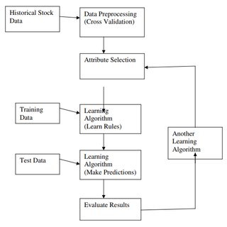
bLOCK DIAGRAM

Slide 7
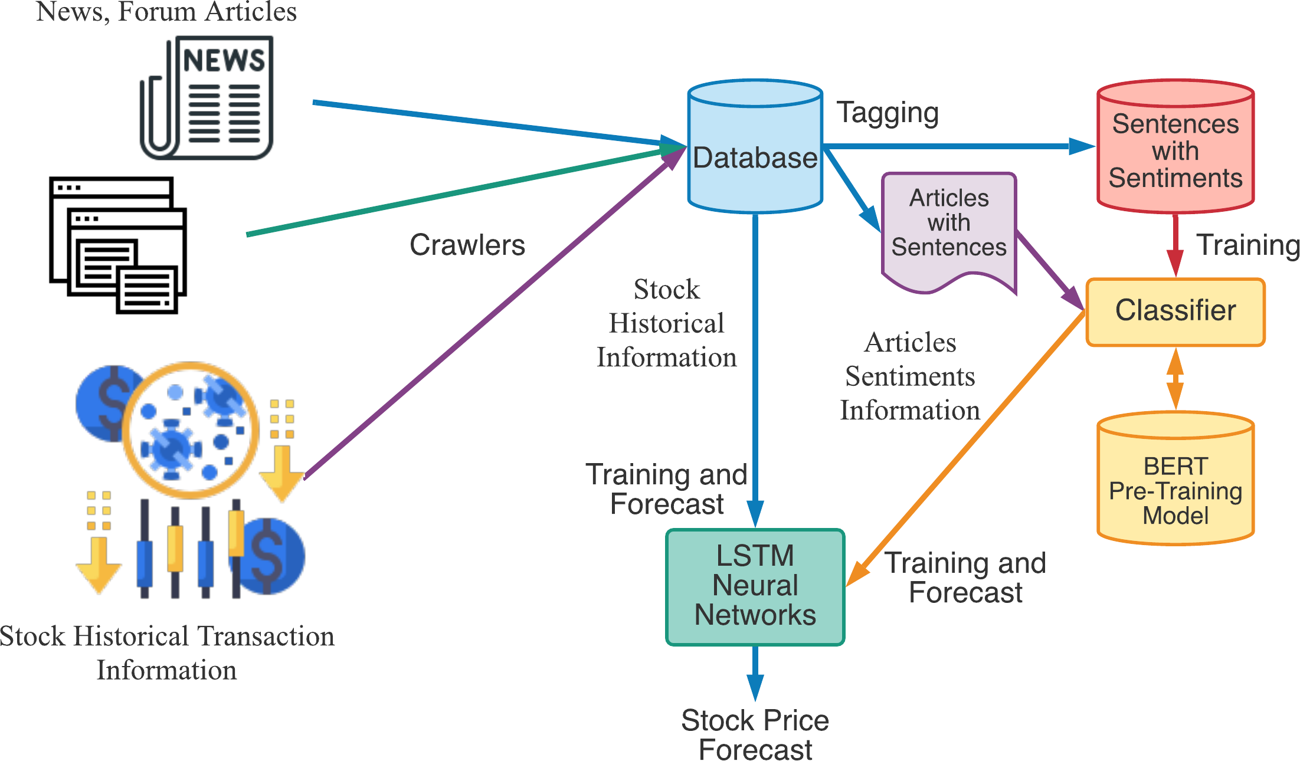
ALGORITHMS USED
Long short-term memory network (LSTM)

Slide 8


TECHNOLOGIES USED
Windows 7/8/10
Python 3.8
VS Code for Front-End

Slide 9
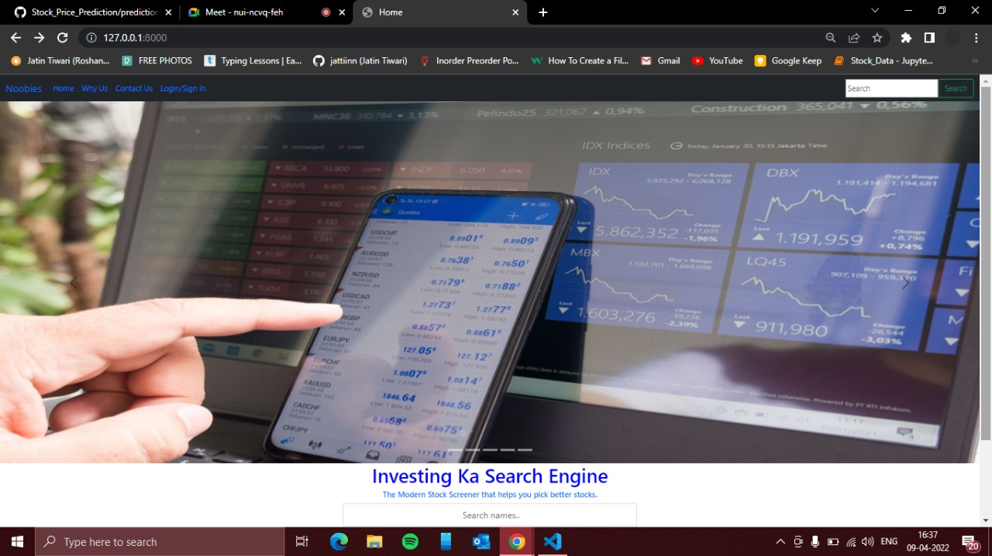

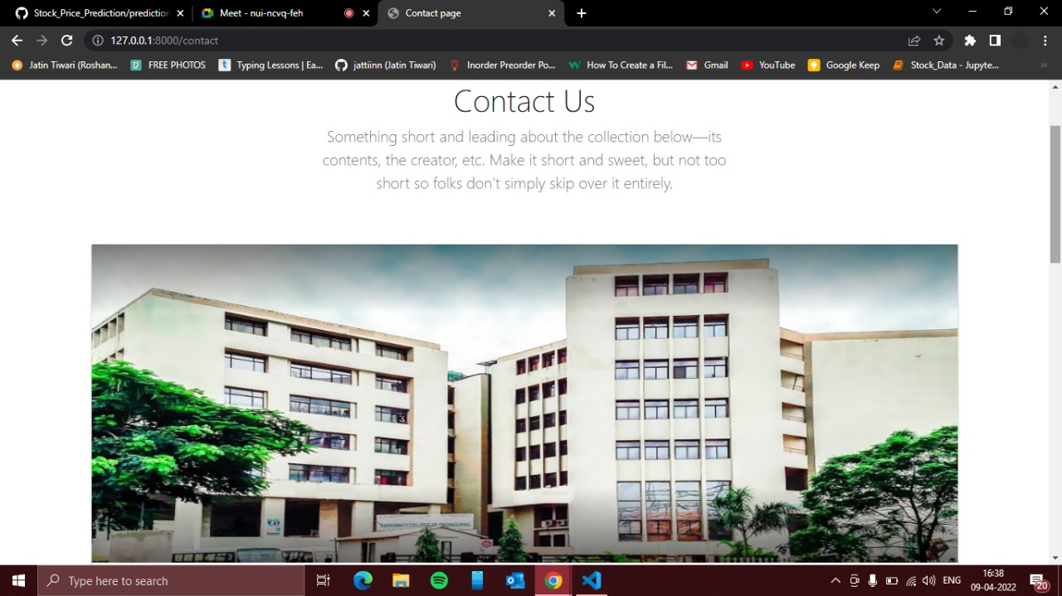
Proposed Design Layout

Slide 10
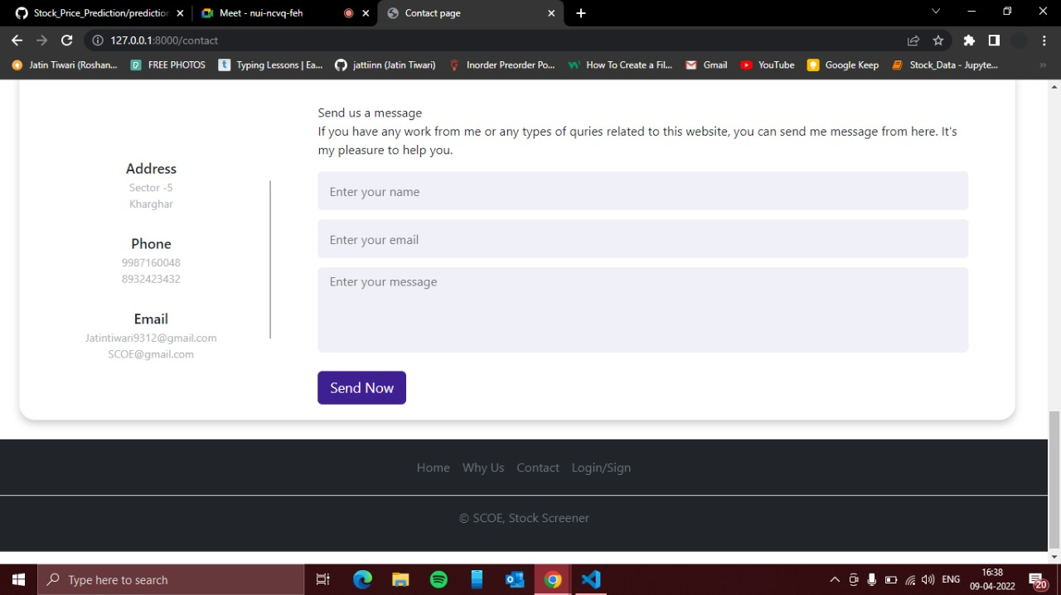
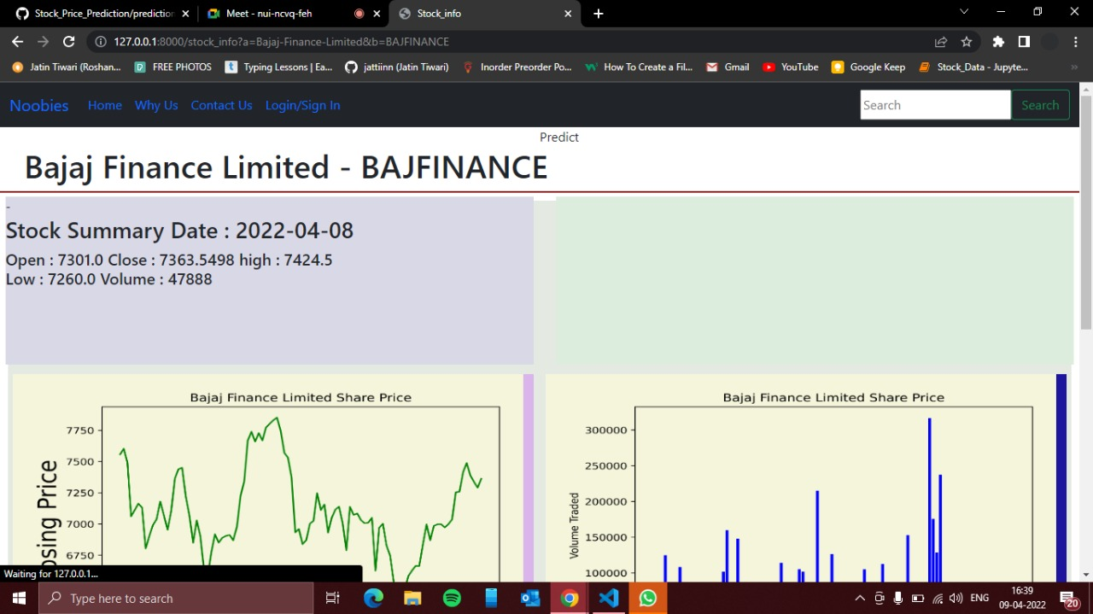
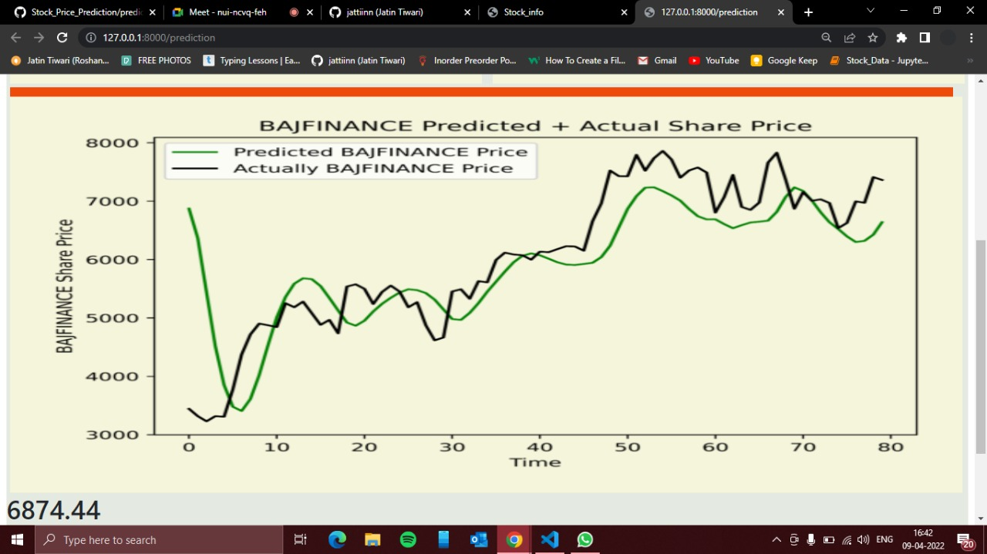

Slide 11
CONCLUSION
The stock market plays a remarkable role.
You’ll learned the basics of the stock market and how to perform stock price prediction using machine learning.
It is possible to predict stock market with more accuracy and efficiency using machine learning techniques.

Slide 12
REFERENCES
https://www.ijert.org/a-literature-survey-on-stocks-predictions-using-hybrid-machine-learning-and-deep-learning-models
https://www.ijert.org/a-literature-survey-on-stocks-predictions-using-hybrid-machine-learning-and-deep-learning-models
https://journalofbigdata.springeropen.com/articles/10.1186/s40537-020-00333-6

Slide 13


